Slide 1
For Live Session Unit 4
By Justin Ehly

Slide 2
Part 1: Restaurant Data from Baltimore!
Note: one of the methods learned in the last unit will work with the the improper XML code that the URL below yields and the other will create an error. Use one to get the job done.
(2- 4 hours)
You have been hired by a restaurateur to some research on Sushi restaurants in Baltimore.
You have come across data on the web contained in the following XML file.
Data: https://d396qusza40orc.cloudfront.net/getdata%2Fdata%2Frestaurants.xml
Scrape the XML page for name, zipcode and city council district. (Use either the XML or rvest package.)
Make a dataframe with just those columns.
Are there any Sushi restaurants in Baltimore? (Where the dataset is from.)
If so, can you estimate how many?
Filter the dataframe for just downtown restaurants (Council District 11).
Are there any Sushi restaurants downtown? # research the “grep” function
If so, estimate how many “Sushi” restaurants are in Downtown
Make a barplot of the estimated number of restaurants (Sushi or otherwise) in each council.

Slide 3
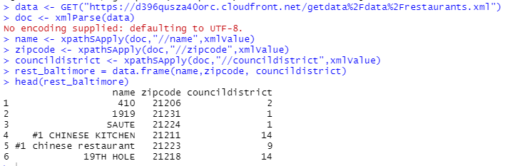
Part 1: Dataframe: Scrape the XML page for name, zipcode and city council district. (Use either the XML or rvest package.)

Slide 4
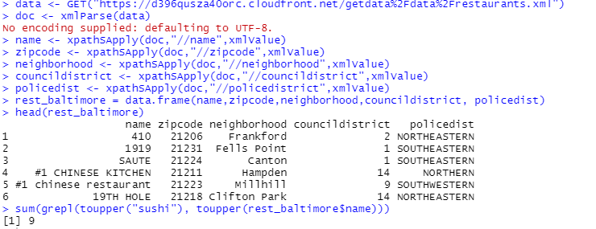
Part 1: Dataframe: Scrape the XML page for name, zipcode and city council district. (Use either the XML or rvest package.)
Are there any Sushi restaurants in Baltimore? (Where the dataset is from.) Yes, 9
If so, can you estimate how many? 9

Slide 5
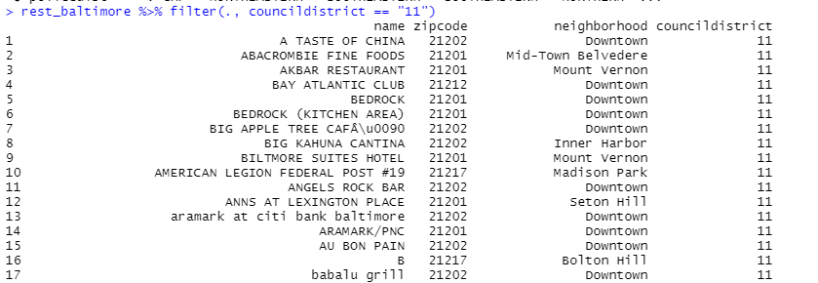
Part 1: Dataframe: Scrape the XML page for name, zipcode and city council district. (Use either the XML or rvest package.)
Filter the dataframe for just downtown restaurants (Council District 11).
Are there any Sushi restaurants downtown? # research the “grep” function
If so, estimate how many “Sushi” restaurants are in Downtown
Make a barplot of the estimated number of restaurants (Sushi or otherwise) in each council.

Slide 6
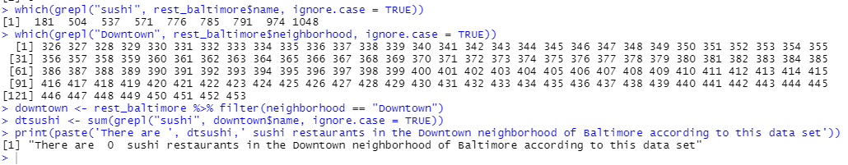
Part 1: Dataframe: Scrape the XML page for name, zipcode and city council district. (Use either the XML or rvest package.)
Are there any Sushi restaurants downtown? # research the “grep” function
If so, estimate how many “Sushi” restaurants are in Downtown

Slide 7
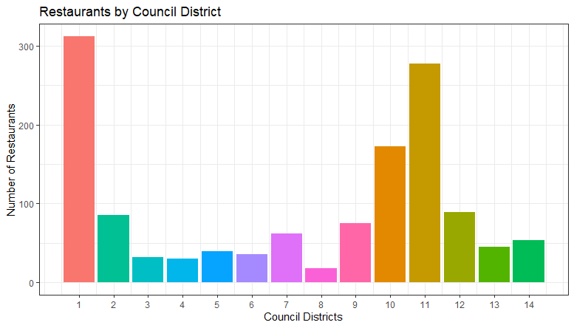
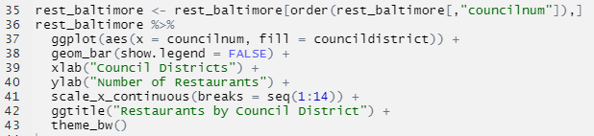
Part 1: Dataframe: Scrape the XML page for name, zipcode and city council district. (Use either the XML or rvest package.)
Make a barplot of the estimated number of restaurants (Sushi or otherwise) in each council.

Slide 8
For Live Session Part 2: Freestyle!
(2 - 4 hours)
Install and load one of the packages given in the list for downloading APIs (or another API you have found and are interested in).
Download data from that API and create a slide that clearly describes the package and how (the code) to download data from that API.
Clearly describe the data and the columns / variables that are of interest to your presentation.
Perform a small EDA with your data. Use plots and possibly tests, to find 2 interesting characteristics of the data that you accessed through the API.
Create a PPT presentation to show in the live session.
Show part or all of the data and make sure to show the data are tidy.
Include at least 1 plot or chart from ggplot.
You should have no more than five slides (including the title slide).
Include your code.
Also include a discussion of any obstacles you ran into and went around or over in the process… there will inevitably be one and likely more. ☺

Slide 9
Download data from that API and create a slide that clearly describes the package and how (the code) to download data from that API.
Package: rtweet (data from the rtweet.pdf users guide found on the cran site listed below)
rtweet is a package of commands to collect and organize Twitter data from the Twitter REST and stream APIs
Imports in httr, jsonlite, magrittr, tibble, utils, progress, Rcpp, httpuv
Link: https://cran.r-project.org/package=rtweet
Suggested packages: ggplot2, knitr, magick, openssl, readr, rmarkdown, testthat, webshot, covr, igraph
3 Main Goals:
Formulate and send requests to Twitter’s REST and stream APIs.
Retrieve and iterate over returned data.
Wrangling data into tidy structures
How to download data from Twitter: There are a variety of ways to download data from twitter using get, list, lookup, search and tweets, examples below
get_tweets for independent searches, returns a datafile by default, standard {free} search is 7-day lookback
get_tweets2 for multiple searches, returns a datafile by default, standard {free} search is 7-day lookback :
search_tweets( q, n = 100, type = "recent“ {“mixed”,”popular”} include_rts = TRUE, geocode = NULL, max_id = NULL, parse = TRUE, token = NULL, retryonratelimit = FALSE, verbose = TRUE, ...)
q_tweets <- c("netflix", "amazonprime", "peacock", "hbomax", "appletvplus", "disneyplus")
example: earch_tweets2(q_tweets, n = 100, type = “mixed”, inlcude_rts = FALSE, lang = "en", geocode = "39.8,-95.583068847656,2500km" )

Slide 10
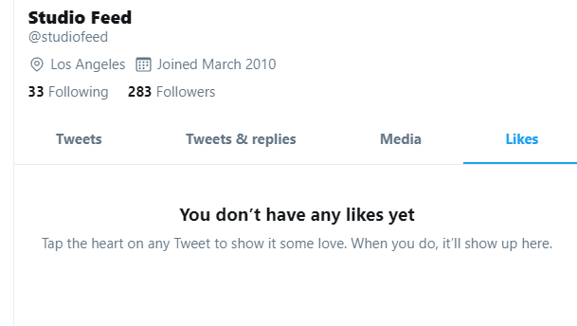

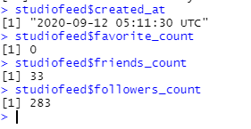
Clearly describe the data and the columns / variables that are of interest to your presentation.
location – location of tweet
source – what platform or app did the tweet come from
hashtags – all hashtags in post
statuses_count – Tweets are also known as “status updates.”
friends_count – total number of users that user follows
followers_count – total number of followers of user
favorite_count – total number of user’s likes
created_at - creation time of tweet
text – actual text of the tweet, in case we want to run some sort of sentiment analysis later on (use tolower() function for this)
query – the specific words queried so help shape the data I was interested in exploring - "netflix", "amazonprime", "peacock", "hbomax", "appletvplus", "disneyplus"

Slide 11
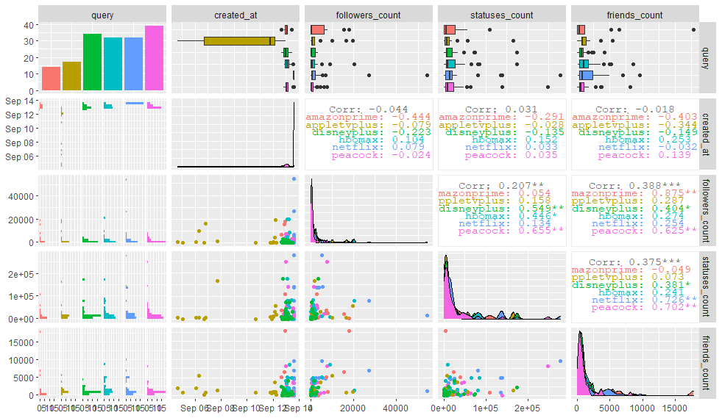
EDA on rtweet data
Categorical Variables
query – the specific words used to query the data
{possibly use later}
location – location of tweet
source – what platform or app did the tweet come from
Continuous Variables
friends_count – total number of users that user follows
followers_count – total number of followers of user
{possibly use later}
created_at - creation time of tweet
statuses_count – Tweets are also known as “status updates.”

Slide 12
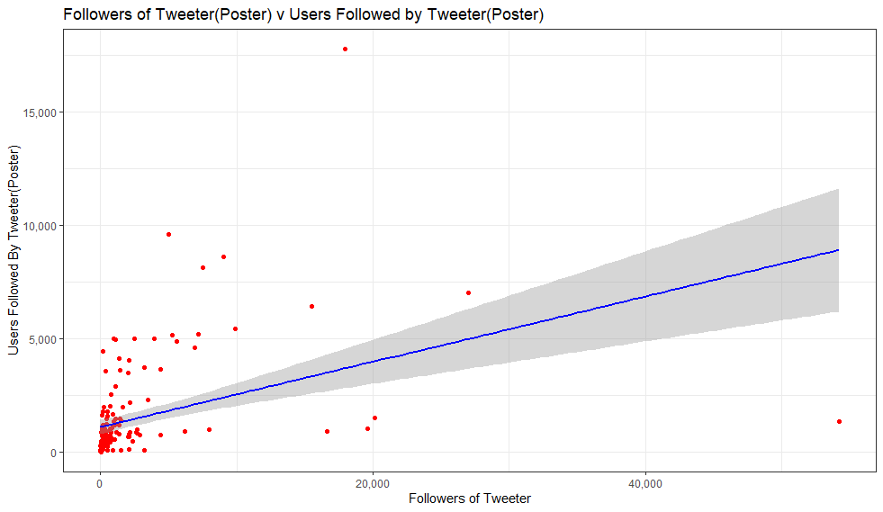
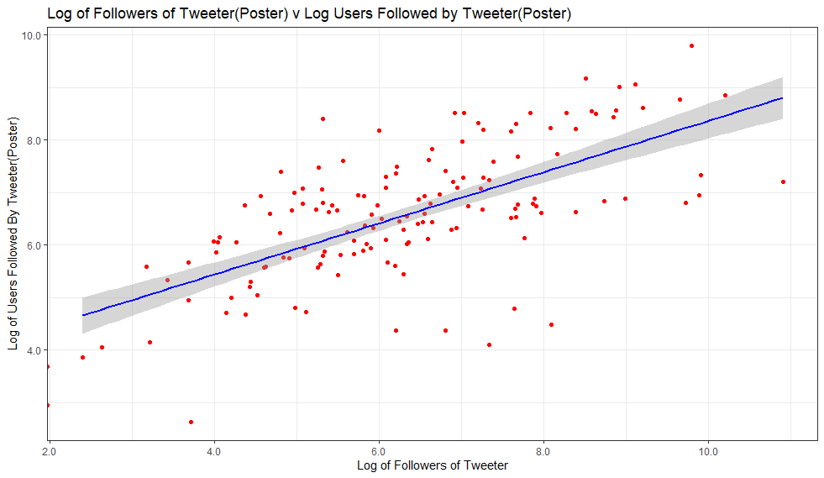
EDA of rtweet
Looks like there might be a positive relationship between followers and friends and status updates.
Q1: Do users with more friends have more followers?
Can’t tell with raw data and it looks like a couple outliers of users who aren’t heavily followed by follow a lot of other users and vice-versa.
Using log-log transformation it looks like there is a positive relationship between Followers (Follow User) and Friends (Followed by User)
Q2: Now, are there confounding variables that may have an effect on the relationship?

Slide 13
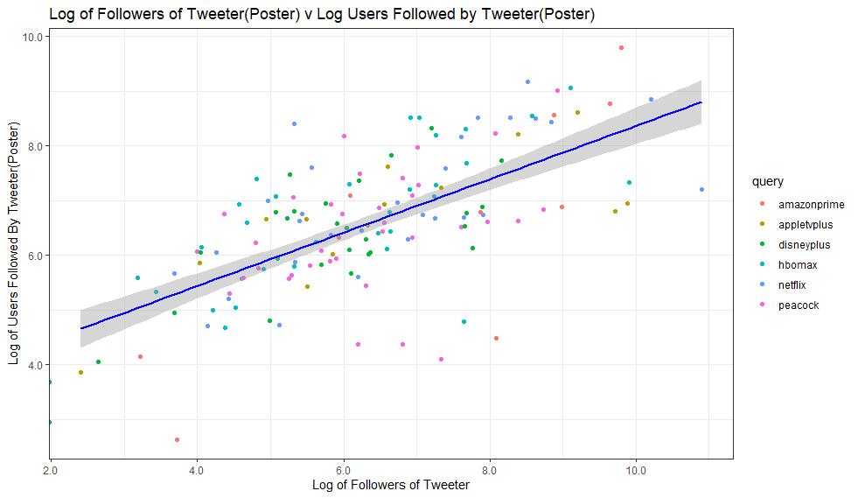
EDA of rtweet
Q2: Are there confounding variables that may have an effect on the relationship?
such as content or context of tweets
such as number of tweets
such as reciprocation (follow each other)
Add in the query colors to the points plot…kind of hard to tell if the posts about each service have any effect on the relationship between Followers and Friends
In conclusion, there is visual evidence tht there is a positive relationship between Followers and Friends on Twitter, based on this simple exercise it is undetermined if the context or topic of the tweet have any effect on that relationship.

Slide 14
Unit 4 – Twitter EDA
by Justin Ehly

Slide 15
EDA on rtweet data
Categorical Variables
query – the specific words used to query the data
{possibly use later}
location – location of tweet
source – what platform or app did the tweet come from
Continuous Variables
friends_count – total number of users that user follows
followers_count – total number of followers of user
{possibly use later}
created_at - creation time of tweet
statuses_count – Tweets are also known as “status updates.”

Slide 16
EDA of rtweet
Looks like there might be a positive relationship between followers and friends and status updates.
Q1: Do users with more friends have more followers?
Can’t tell with raw data and it looks like a couple outliers of users who aren’t heavily followed by follow a lot of other users and vice-versa.
Using log-log transformation it looks like there is a positive relationship between Followers (Follow User) and Friends (Followed by User)
Q2: Are there confounding variables that may have an effect on the relationship?
such as content or context of tweets
such as number of tweets
such as reciprocation (follow each other)
Add in the query colors to the points plot…kind of hard to tell if the posts about each service have any effect on the relationship between Followers and Friends
In conclusion, there is visual evidence tht there is a positive relationship between Followers and Friends on Twitter, based on this simple exercise it is undetermined if the context or topic of the tweet have any effect on that relationship.

Slide 17
EDA of rtweet: code
#confirm token and app name
get_token()
#check rate limits
rate_limit(token)
rate_limit(token, "search_tweets")
#query to search twitter with
q_tweets <- c("netflix", "amazonprime", "peacock", "hbomax", "appletvplus", "disneyplus")
#run multiple queries using search_tweets2 (search_tweets only does independent queries), by default
# returns a dataframe, geocode:39.8,-95.583068847656,2500km is the lower 48 states - ish
# Tidy Data
tweets <- data.frame(search_tweets2(q_tweets, n = 500, type = "mixed", include_rts = FALSE, lang = "en", geocode = "39.8,-95.583068847656,2500km" ))
class(tweets)
twts <- tweets
twts <- tibble::as_data_frame(twts)
variable.names(twts)
str(tweets)
# remove unused variables
twts <- drop(select(tweets, -c("is_retweet", "retweet_status_id","retweet_text", "retweet_created_at","retweet_source", "retweet_favorite_count", "retweet_retweet_count", "retweet_user_id","retweet_screen_name","retweet_name", "retweet_followers_count","retweet_friends_count","retweet_statuses_count","retweet_location","retweet_description","retweet_verified")))
variable.names(twts)
twts <- twts[,c(3,4,5,6,16,57,58,62,63,65,75) ]
twts <- twts[, c(2,8,9,10,11,1,4,7,6,3,5)]
colnames(twts)
twts <- na.omit(twts)
#Reorganize Columns
twts <- twts[, c(2,8,9,10,11,1,4,7,6,3,5)]
twts <- na.omit(twts)
twts %>%
select(query, created_at, followers_count, statuses_count, friends_count) %>%
ggpairs(aes(color = query))
twts %>%
ggplot(aes(x = followers_count, y = friends_count)) +
geom_point(color="red") +
geom_smooth(method = glm, color = "blue") +
scale_y_continuous(label = scales::comma) +
scale_x_continuous(label = scales::comma) +
xlab("Followers of Tweeter") +
ylab("Users Followed By Tweeter(Poster)") +
ggtitle("Followers of Tweeter(Poster) v Users Followed by Tweeter(Poster)") +
theme_bw()
twts %>%
ggplot(aes(x = log(followers_count), y = log(friends_count))) +
geom_point(aes(color = query)) +
geom_smooth(method = glm, color = "blue") +
scale_y_continuous(label = scales::comma) +
scale_x_continuous(label = scales::comma) +
xlab("Log of Followers of Tweeter") +
ylab("Log of Users Followed By Tweeter(Poster)") +
ggtitle("Log of Followers of Tweeter(Poster) v Log Users Followed by Tweeter(Poster)") +
theme_bw()

Slide 18
Obstacles
Discovering what each of the Twitter variables represented (see Appendix)
Tidy data:
removing unwanted columns -> drop function to drop by variable name, df <- df[,c( xxx)] -> to just keep variables by column number or name, df <- df[,-c()] to remove additional variables
removing na’s -> na.omit(df)
reorganizing variables/ columns -> df <- df[,c( new order)]
confirming correct changes -> variable.names(df)
as.Date.POSIXct to parse date data into a variable
strftime(df$xx, format = “%T:%00) -> time by UTC = 00
strftime(df$xx, format = “%H) -> hour (24hr format)
strftime(df$xx, format = “%A) -> day of week
strftime(df$xx, format = “%p) -> AM/PM designation
Formatting ggplots
adding commas to axis -> scale_y_continuous(label = scales::comma) + scale_x_continuous(label = scales::comma)

Slide 19
Appendix – Describe Data Variables
location – location of tweet
source – what platform or app did the tweet come from
hashtags – all hashtags in post
statuses_count – Tweets are also known as “status updates.”
friends_count – total number of users that user follows
followers_count – total number of followers of user
favorite_count – total number of user’s likes
created_at - creation time of tweet
text – actual text of the tweet, in case we want to run some sort of sentiment analysis later on (use tolower() function for this)
query – the specific words queried so help shape the data I was interested in exploring - "netflix", "amazonprime", "peacock", "hbomax", "appletvplus", "disneyplus"

